Slide 1
Module 17

Slide 2
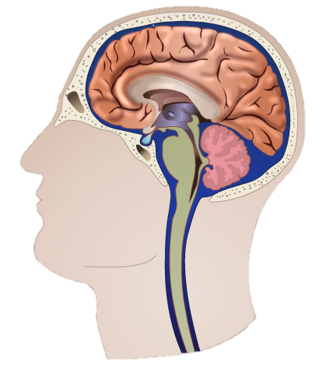
Brain is divided into three main regions which are
Fore brain
Mid brain
Hind brain

Slide 3
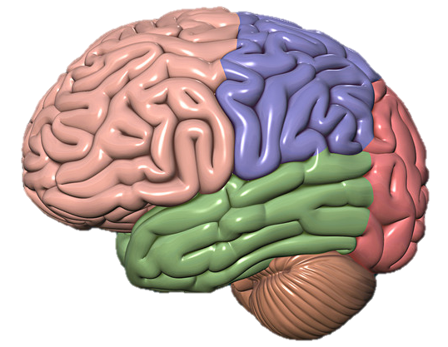
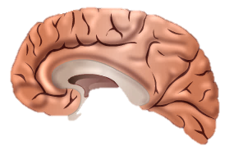
There are different areas for smell hearing vision etc.
Movement
Touch
Thought
Fore brain
is also called as Cerebrum
and it is the main thinking part of the brain.
Speech
Vision
Hearing

Slide 4
Mid brain and
Hind brain
Controls involuntary actions

Slide 5
Cerebellum maintain the balance
Medulla oblongata controls involuntary activities like.
and coordinates voluntary activities.
Breathing
Blood flow
Sneezing
Balance
Cycling
Walking
Eating
consists of
Hind brain
Cerebellum
Medulla oblongata

Slide 6
Thank You

